Slide 1
National Family Health Survey
Household Data ~ 600K

Slide 2
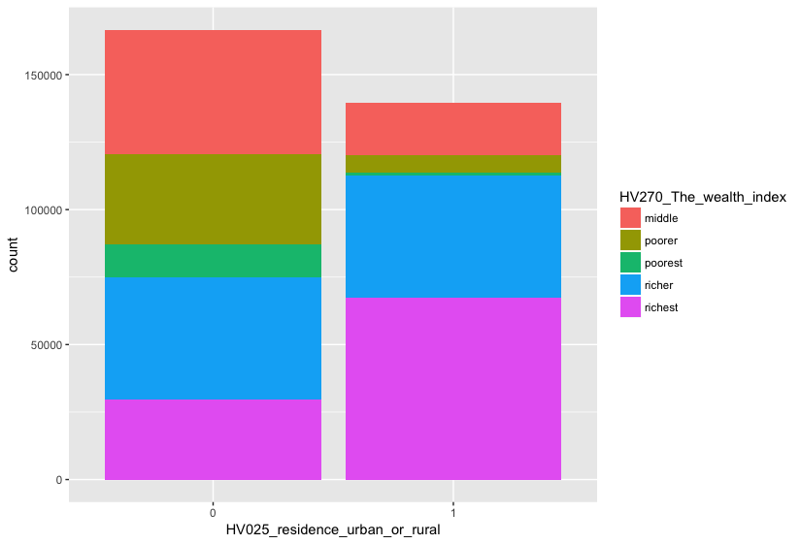
Among 6,01,509 Households, Over - Representation of Non-Rich Wealth Segments in Rural(0), and Rich in Urban(1) Areas
44% in poor segments; 20% in middle segment;
37% in rich segments
<Wealth> <Rural or Urban> <PCT>
middle 0 15%
middle 1 5%
poorer 0 19%
poorer 1 2%
poorest 0 21%
poorest 1 1%
richer 0 10%
richer 1 9%
richest 0 6%
richest 1 12%

Slide 3
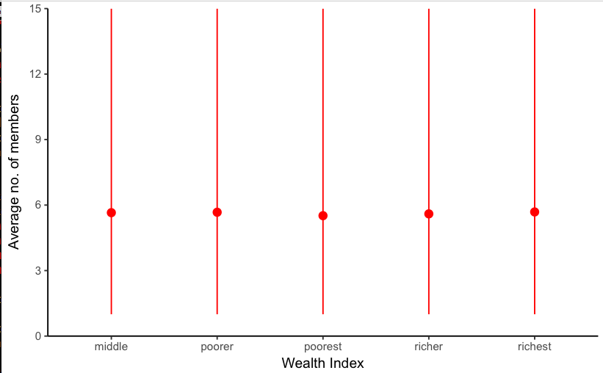
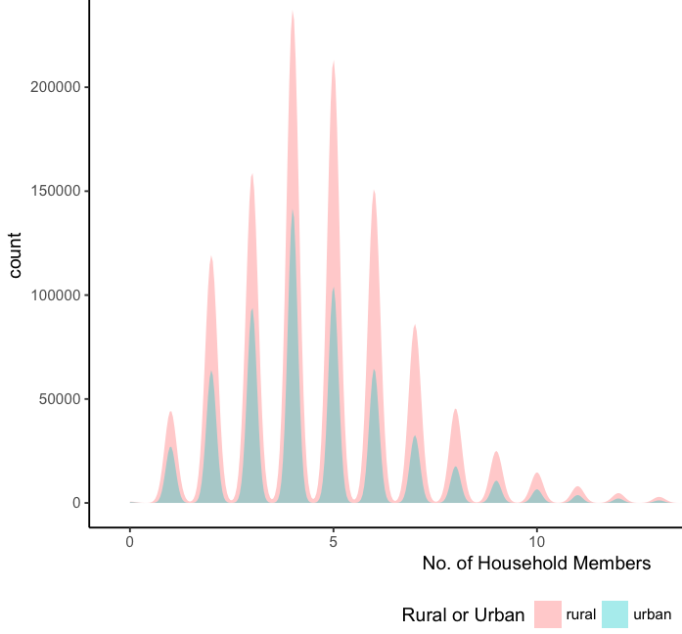
Mean No. of Household Members is 5-6
2. Density is highest for 4 member Households in Rural & Urban
Notes:
9: Total number of household members indicates the number of entries to be found in RECH1.
12: Total number of de jure household members gives the number of household members that usually live in the household.
Tot13:al number of de facto household members gives the number of household members that slept in the household the previous night, including visitors.

Slide 4
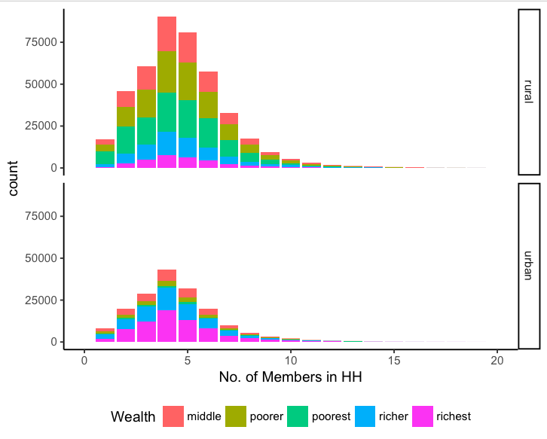
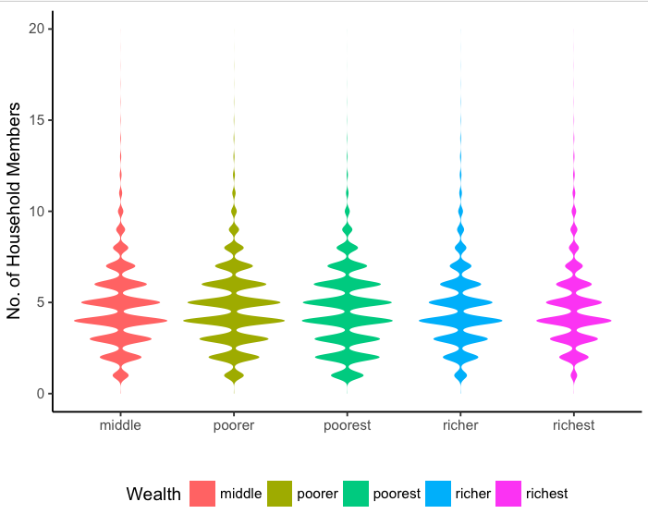
Rural HH in Poorer & Poorest Wealth, 5-6 Member constitute 8% each. Urban Richest, 5-6 Member is 5%
<Range> <Total> <%>
1. 372 0%
2. 25244 4%
3. 65443 11%
4. 89379 15%
5. 133633 22%
6. 112996 19%
7. 77209 13%
8. 42994 7%
9. 22830 4%
10. 12883 2%
Total number of de jure household members gives the number of household members that usually live in the household.
Notes:
# A tibble: 16 x 4
HV025_residence_urban_or_rural Total_Members n Frequency
<fct> <fct> <int> <chr>
1 0 36-40 117268 19%
2 0 31-35 171354 28%
3 0 26-30 5 0%
4 0 21-25 60556 10%
5 0 16-20 76 0%
6 0 11-15 45995 8%
7 0 6-10 2684 0%
8 0 0-5 27625 5%
9 1 36-40 38648 6%
10 1 31-35 75278 13%
11 1 26-30 2 0%
12 1 21-25 28843 5%
13 1 16-20 21 0%
14 1 11-15 19894 3%
15 1 6-10 931 0%
16 1 0-5 12329 2%
>

Slide 5
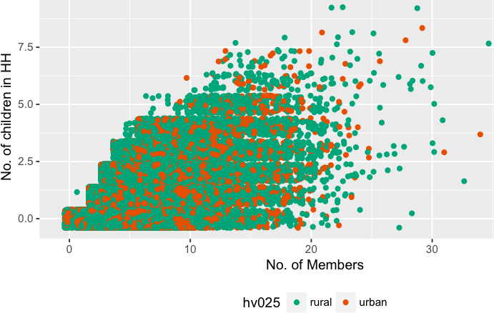
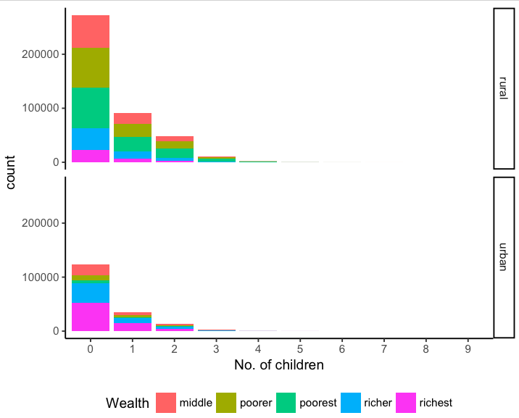
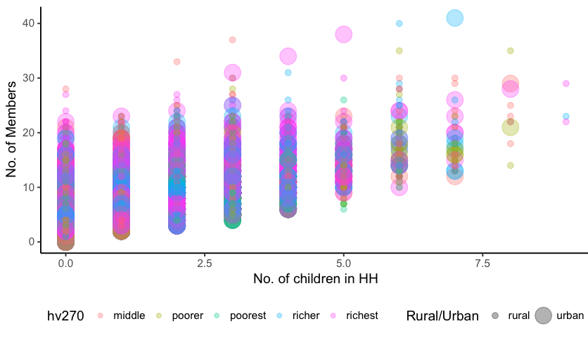
No. of Children vs. Household Members by Wealth Index:
Each of 4 lakh HH have just 1 child.
Out of 24% urban HH who have 1 child, 74% have 3-6 members.
34% of rural HH have 1 child, 48% 3-6 & 10% have 7-8 members.

Slide 6
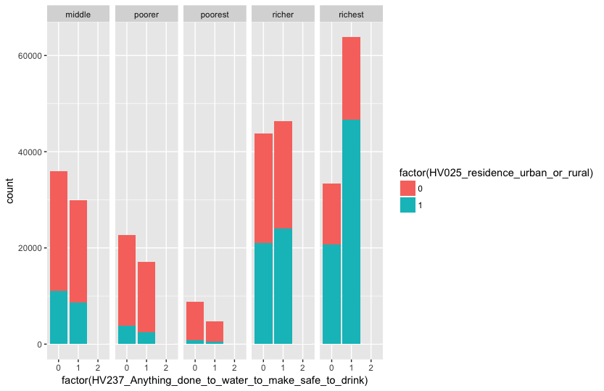
Urban Rich Households More Likely to Make Water Safe.
0/1 = Rural/Urban & 0/1/2 = No/Yes/Don’t Know
46% of the rural, & 13% of urban HH, do not use safe water.
Among these rural HH, 17% are poorest & 13% are poorer, and 9% are middle.

Slide 7
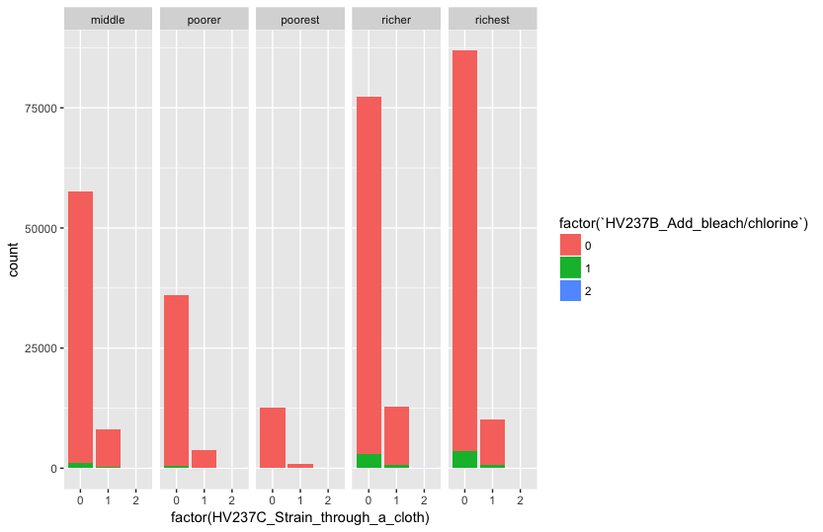
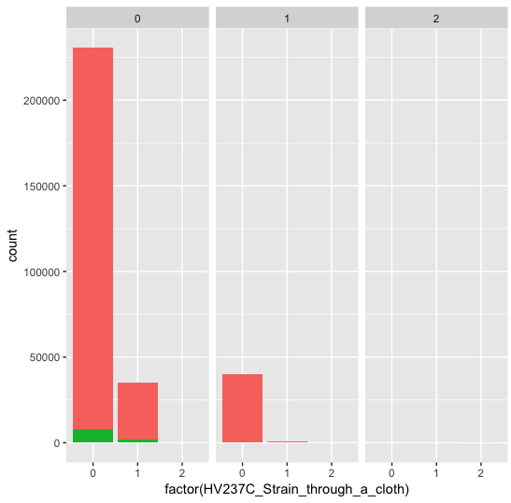
Straining by Cloth, Filtering Water, & Adding Bleach are not popular among any HHs in any Wealth Segment.
Does HH Filters Water?
0: No
1: Yes
2: Don’t Know

Slide 8
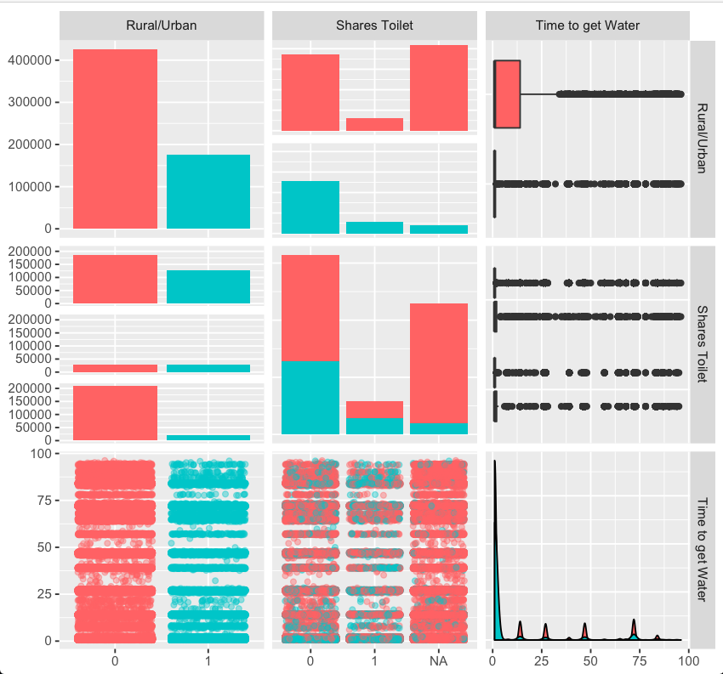
Rural or Urban vs. “Shares Toilet?” vs. “Time Spent to get Water” in Surveyed Households
There are 50% more rural HH than urban HH.
71% rural & 88% of urban HH spend 10 minutes to get water; while 10% & 5% spend 1+ hour respectively.
31% rural & 21% urban HH share toilets.

Slide 9
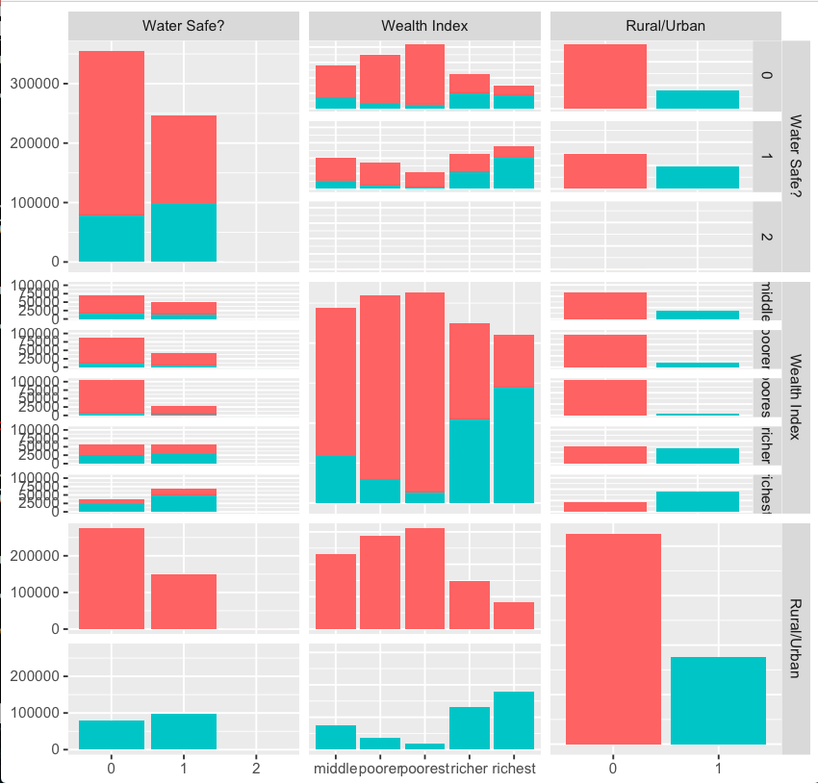
“Safe Water Used?” vs. “Wealth Index” vs. “Rural or Urban” in Surveyed Households
Slightly more urban HH use clean water. Rich HH in both rural & urban are likelier to use clean water.

Slide 10
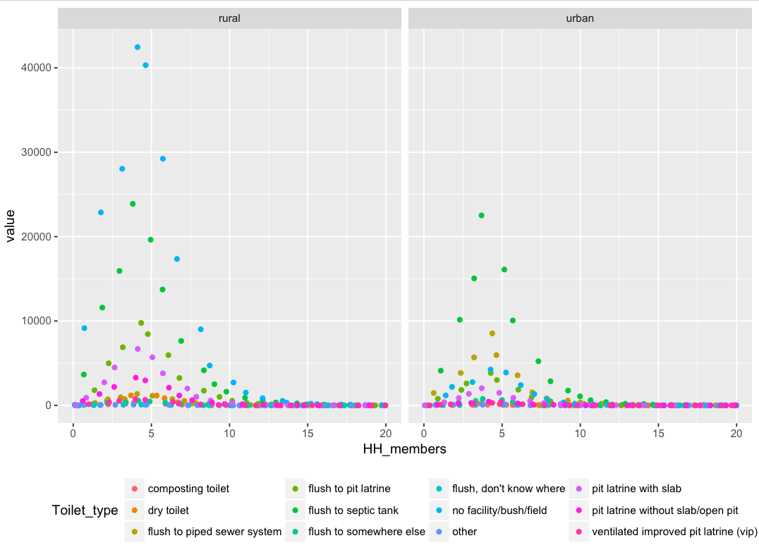
“Toilet Type” vs. “Rural or Urban” vs. Household Members
35% of rural & 3% of urban HH have “no facility/bush/field”. While 18% of rural & 15% of urban HH use “flush to septic tank”.

Slide 11
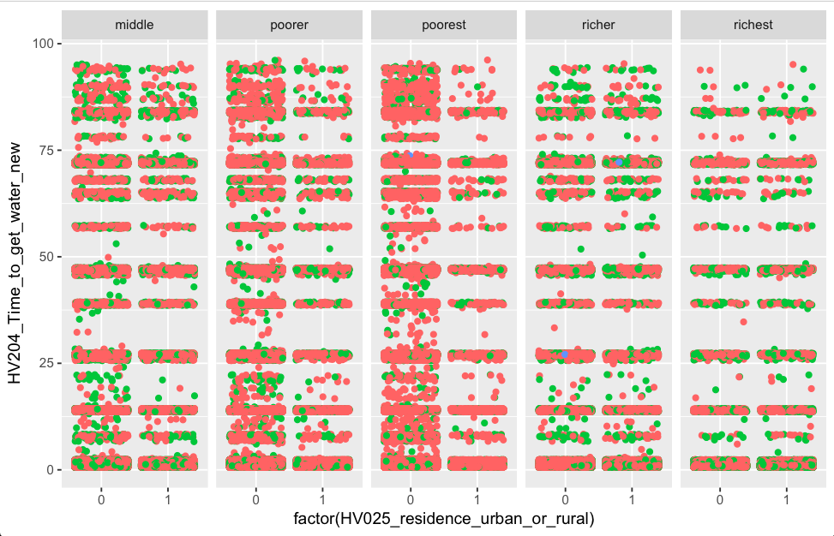
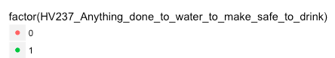
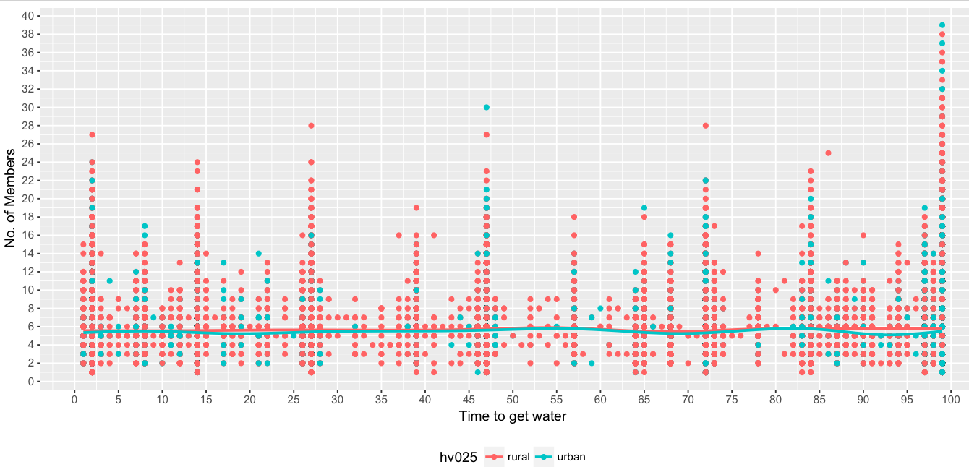
Time Spent to get Water, by Wealth & Making Water Safe in Rural (0)/Urban(1).
Time Spent to get Water vs. No. of Members, in Urban/Rural.
Rural & poor segments don’t use safe water & spend more time to get water. Large member families spend highest time in rural areas.

Slide 12
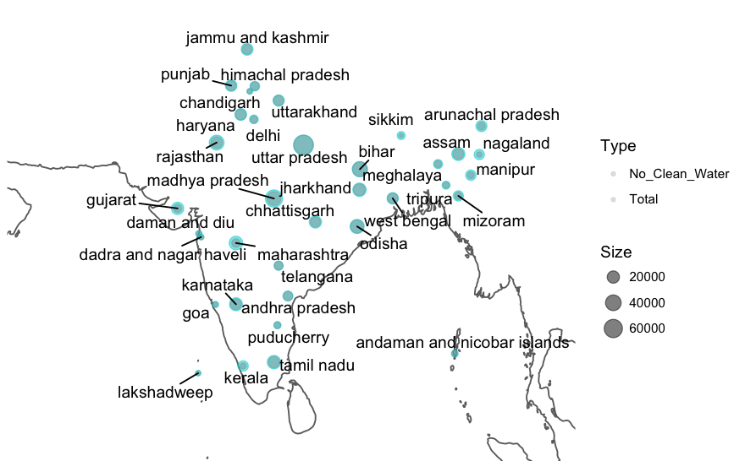
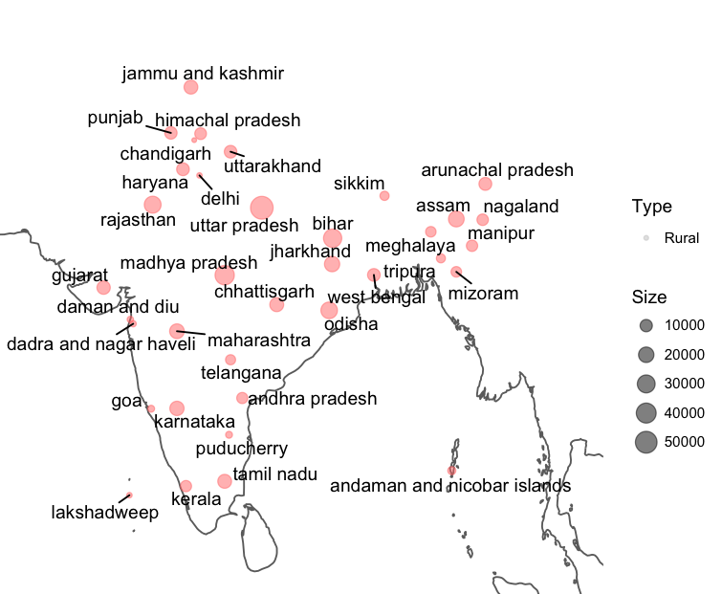
1. Total Households
2. Total Rural Households
Rural households are high in MP, UP and Bihar. These states also have highest total households.

Slide 13
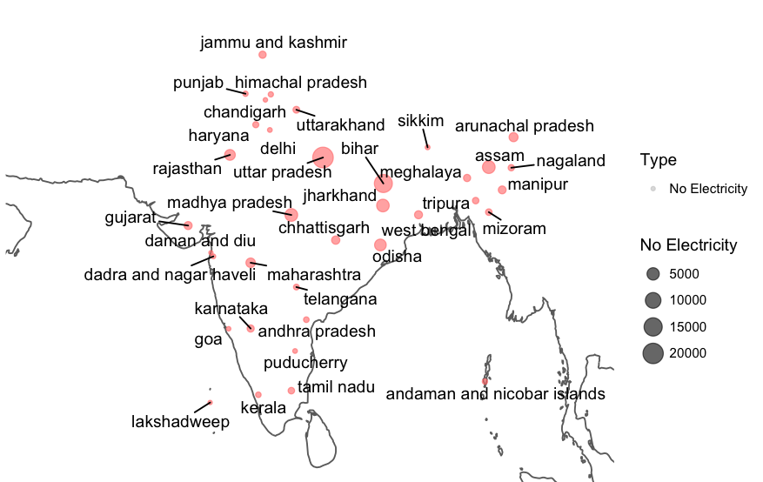
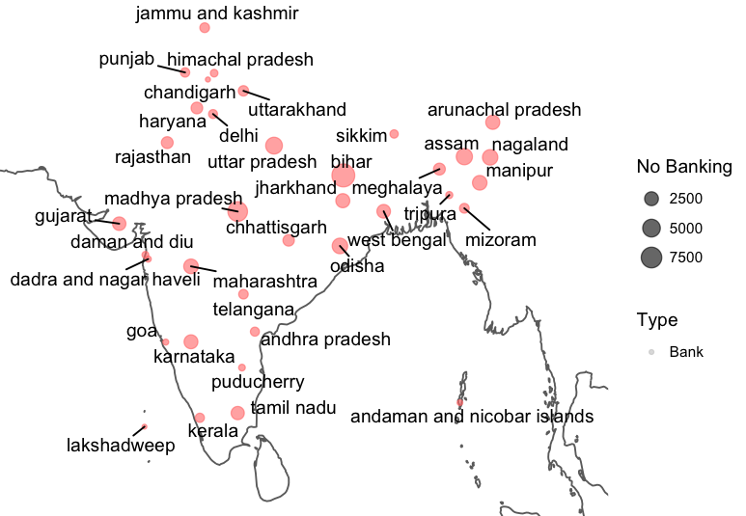
Absence of Electricity & Banking in Surveyed Households
UP and Bihar have the highest number of households with no electricity.
Bihar highly suffers from unbanked households.

Slide 14
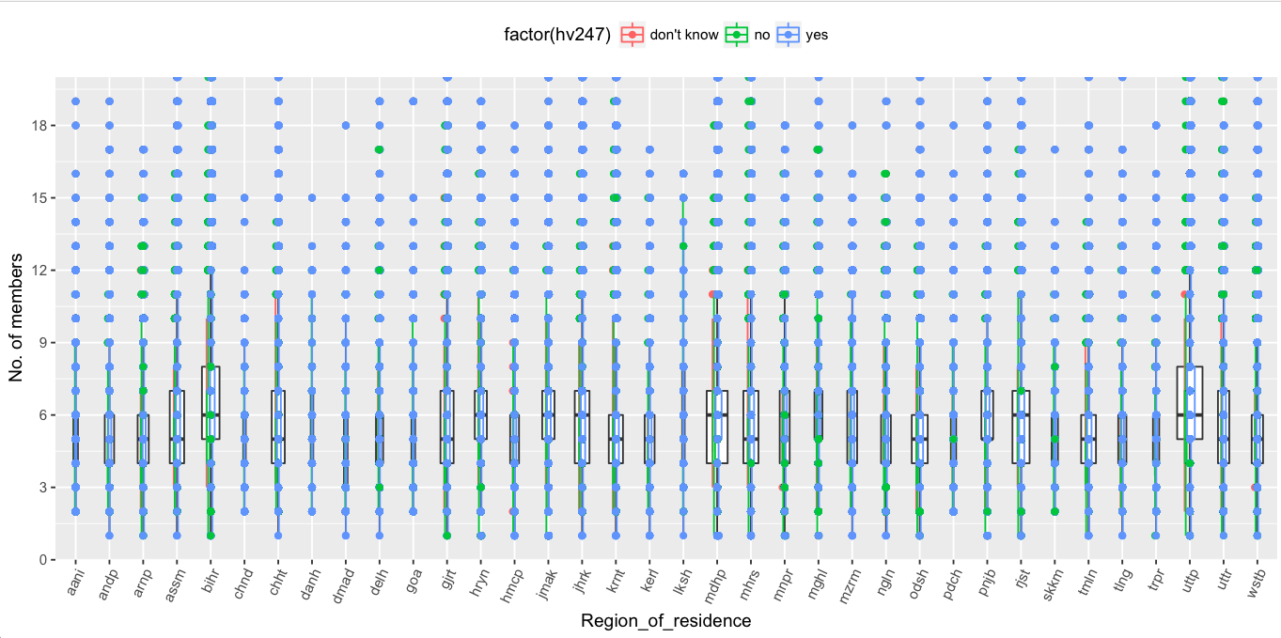
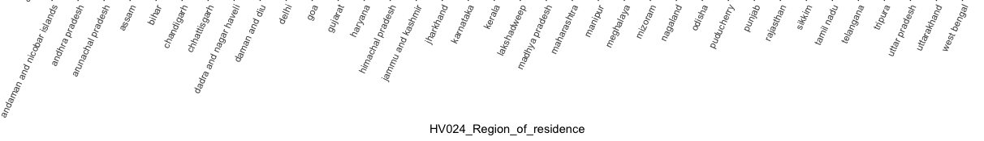
No. of Members in a HH, who have Bank A/C, by States
Bank A/C
Northeastern states like Nagaland and Arunachal Pradesh have a large range of no. of members in HH; while J&K and Haryana have a small range and more members in HH. UP state has most no. of surveyed HH. Rajasthan has more HH with bank a/cs.

Slide 15
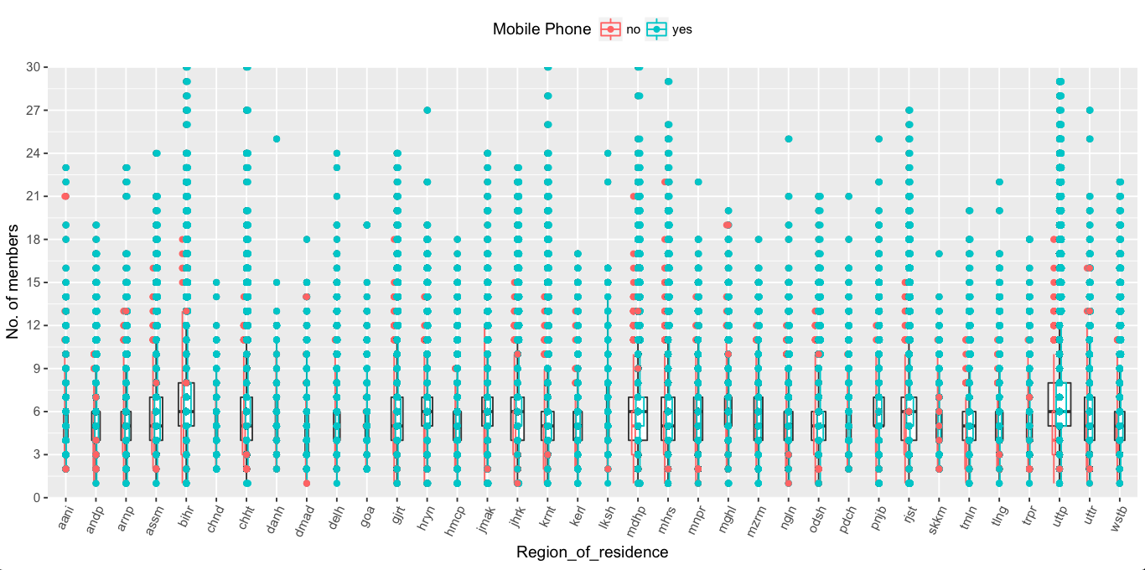
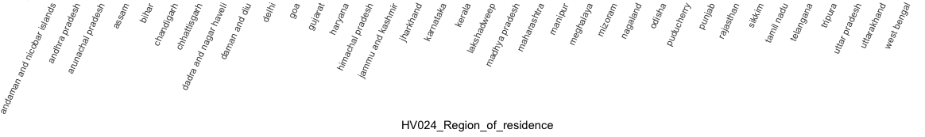
No. of Members in a HH, who have Mobile Phones, by States
Households are likelier to have a bank account than mobile phone.

Slide 16
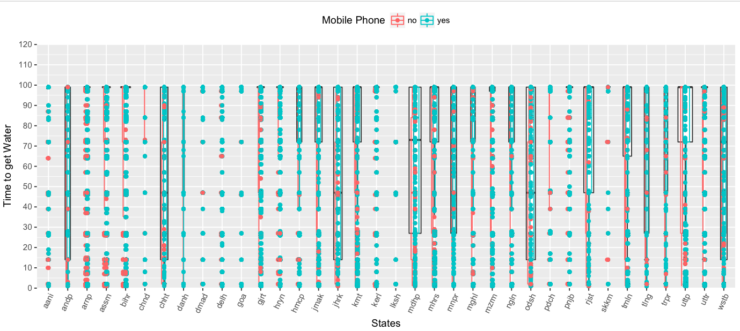
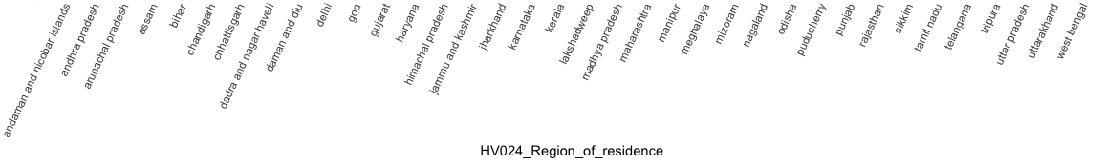
Trends by Time Spent in Getting Water by a Household, Who Have Mobile Phones, by Member States
Almost all Households in Haryana & J&K spend a lot of time in getting water. States like Andhra Pradesh, Chhatishgarh, Jharkhand, Odisha, WB and MP have a very high range in time spent in getting water. Lack of mobile phone is most acute in Nagaland.

Slide 17
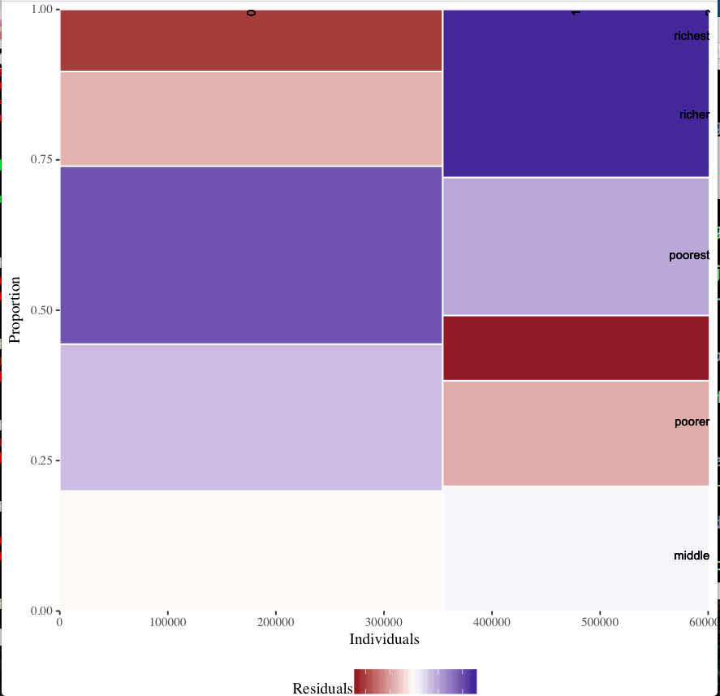
Wealth Index vs. “Clean Water Used” in Surveyed Households
Frequency of poorest using clean water AND rich HH not using clean water are less than expected.
Frequency of rich HH using clean water AND poorest HH not using clean water, are more than expected.
Notes:
A mosaic plot is a square subdivided into rectangular tiles the area of which represents the conditional relative frequency for a cell in the contingency table. Each tile is colored to show the deviation from the expected frequency (residual) from a Pearson X² or Likelihood Ratio G² test.
You can use the mosaic plot to discover the association between two variables. Red tiles indicate significant negative residuals, where the frequency is less than expected. Blue tiles indicate significant positive residuals, where the frequency is greater than expected. The intensity of the color represents the magnitude of the residual.

Slide 18
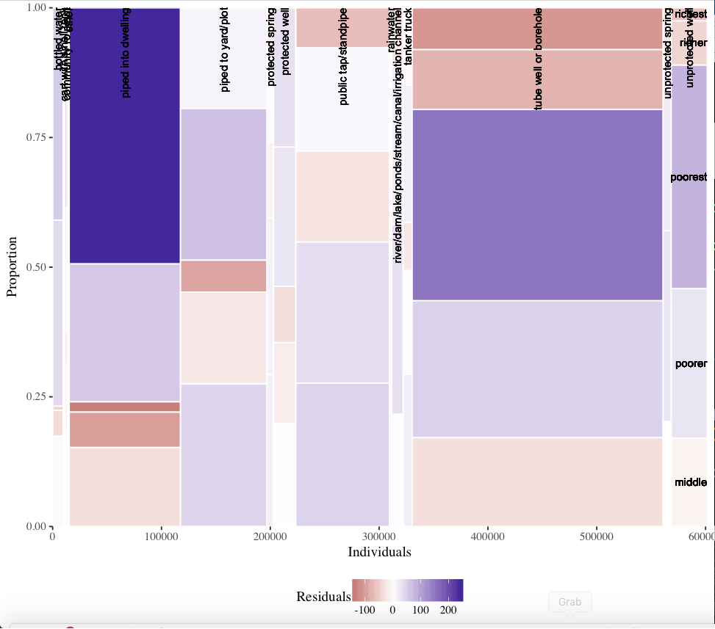
Wealth Index vs. “Where Water is Taken From”
Frequency of richest using “piped into dwelling” AND poorest using “tubewell or borehole” more than expected.

Slide 19
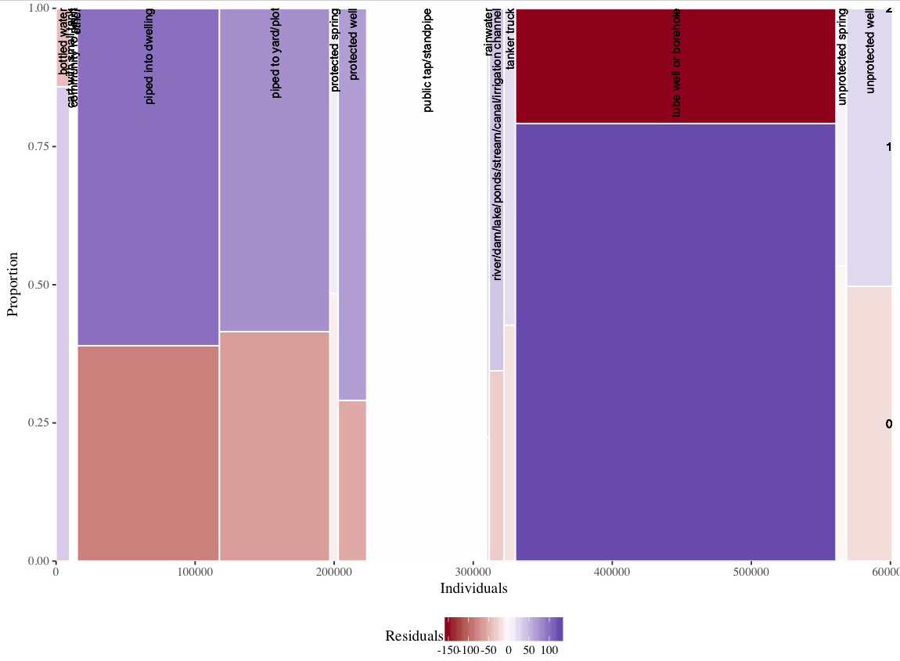
“Where Water is Taken From” vs. “Clean Water?”
Severe under-representation of clean water from “tubewell or borewell”.

